Slide 1


Middle Temple Library
Effective online research

Slide 2
Effective Research
Structuring research saves time:
  Eliminates irrelevant sources
  Avoids duplication of work
  Produces relevant results
  Makes future research quicker
Take notes at each stage of your research
If you are struggling to find the right information:
  Consider new search strategies
  Seek assistance
    See final slide for Library contact information

Slide 3
Structuring Research
Identify Questions
What do you need to know?
Put your questions into research terms
Identify: subjects, keywords, search terms, related areas
Choose relevant finding tools & sources
Consider: authority, subject, format, jurisdiction, cost availability
Undertake research
Make notes as you work

Slide 4
Reviewing Research
Identify any missing information
Did you answer every question?
Did you find information that creates new questions?
Revise search terms, consider other sources & continue research if necessary.

Slide 5
Boolean Logic
AND
results contain both terms
OR
results contain either term
NOT
discards results that contain the second term
Databases may replace Boolean terms with symbols or use different search operators
  Many databases read a space between words as AND
  Westlaw uses % for NOT
  Google uses – for NOT
  HeinOnline requires Boolean operators to be in ALL CAPS
  Lexis uses ATLEAST followed by a number to indicate how many times a word will appear in each document

Slide 6
Try It
Search the BAILII database for:
dangerous AND animals
Then search for:
dangerous AND animals NOT dogs
What is the difference in the results?
  The second search should produce significantly fewer results, by removing any that refer to dogs.

Slide 7
Phrase Searching
Quotation Marks “ ”
Round Brackets ( )
Searches for words as a phrase
Words appear next to each other exactly as typed
Useful when searching for a phrase containing a Boolean operator
Structures the order keywords are searched
Personal or professional negligence ≠ (personal or professional) negligence
  The first searches ‘personal’ and then ‘professional negligence’
  The second searches ‘personal negligence’ and then ‘professional negligence’

Slide 8

Try It
Search the BAILII database for:
  trick or treat
Then search for:
  “trick or treat”
What is the difference in the results?
  The first search finds any results that have the word ‘trick’ or the word ‘treat’.
  The second finds far fewer results, since it finds only those with the phrase ‘trick or treat’.

Slide 9
Truncation
$
Middle Temple Library catalogue
!
Lexis
*
BAILII
JustCite & Justis
Hein Online
Westlaw
Westlaw US
EUR Lex
Lawtel
HUDOC
Google
Search variations of a word by using a truncation (or root expander) symbol
  For example: sentenc$ = sentence, sentences, sentencer, sentencing, etc.
The truncation symbol varies across databases

Slide 10
Advanced Searching
Search for information in the correct field
Narrow down or sort results to limit to relevant results
Use advanced search options for more specific results
Remember: databases offer a range of options for building complex searches
  See database details for specific search terms and symbols

Slide 11
Try It
2000
Search the BAILII database for:
  millennium
Then find the Advanced Search screen and search for:
  millennium with a date range from 1999 to 2000
What is the difference in the results?
  The second search produces far fewer results, with cases only from the selected years.

Slide 12
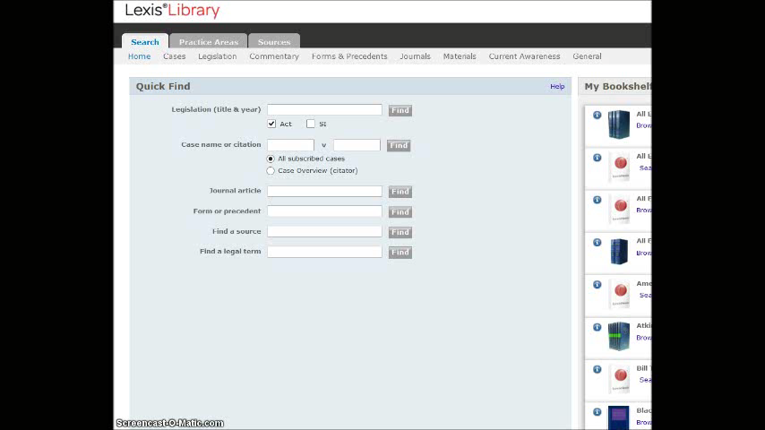
Field Searching Video

Slide 13
Search Engines
More than just Google
  Duckduckgo does not track your activity
Google advanced search: www.google.com/advanced_search
More productive than some website’s internal search engines
  Site/domain limiter searches only specific types of website
    For example: parliament.uk
Not a replacement for databases!
You must evaluate all sources:
  Notice the design and look
    Are official logos or references accurate?
  Is the site up-to-date?
  Consider who produced the information
    Is the writer biased? Is the research thorough?
  Note the ending of the web address
    For example: .ac.uk, .edu, .eu, .gov, .org, etc.

Slide 14

Try It
Search Google Advanced Search for a copy of:
  “Montreal Protocol” No. 4 1975, hosted directly by the UN (un.org)
How does this compare to searching the UN Treaty Collection database directly?
Note: Google only recognises certain search operators in specific formats
  Full list of search operators:
  support.google.com/websearch/answer/136861?p=adv_operators&hl=en

Slide 15
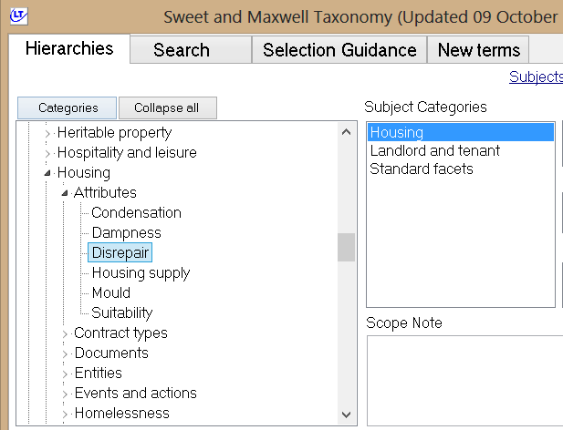
Synonyms
Search for synonyms or related terms to produce more results
Different databases use different keywords & subject headings
View the subject hierarchy
to choose more precise or
general terms
Sweet & Maxwell’s subject hierarchy shows how keywords fit together

Slide 16
Spelling & Context
Search under alternate spellings of words
  Especially important in American and historical databases
  Use symbols to replace letters as necessary, use the ‘or’ operator, or run multiple searches
Secondary context for a term may produce unrelated results
  For example: ‘caution’ produces results related to both the police and land register

Slide 17
Middle Temple Library
Further questions? Need more training or advice?
Contact the Library at:
Middle Temple Lane, London, EC4Y 9BT
020 7427 4830
library@middletemple.org.uk
www.middletemplelibrary.org.uk

